Slide 1

CS106A
Control Flow
Control Flow Revisited
Chris Piech
CS106A, Stanford University

Slide 2
Review

Slide 3

Java

Slide 4
Making a New Variable
type
name
int age = 29;
Initial value

Slide 5
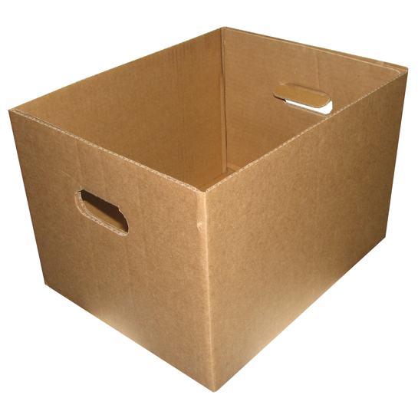
Teeny Tiny Boxes
My computer has space for about 2 billion boxes

Slide 6
Create, Modify, Use
// Create a variable, of type int
// called age with the value 29.
int age = 29;
// Modify age to be one greater.
age = age + 1;
// Use the value in age (output it)
println(“age is: ” + age);

Slide 7
Receipt Program
public class Receipt extends ConsoleProgram {
public void run() {
double subtotal = readDouble(”Meal cost? $”);
double tax = subtotal * 0.08;
double tip = subtotal * 0.20;
double total = subtotal + tax + tip;
println("Tax : $” + tax);
println("Tip: $” + tip);
println(”Total: $" + total);
}
}

Slide 8
Constants
constant: A variable that cannot be changed after it is initialized. Declared at the top of your class, outside of the run() method. Can be used anywhere in that class.
Better style – can easily change their values in your code, and they are easier to read in your code.
Syntax:
private static final type name = value;
name is usually in ALL_UPPER_CASE
Examples:
private static final int DAYS_IN_WEEK = 7;
private static final double TAX_PERCENT = 0.08;
private static final int SSN = 658234569;

Slide 9
Receipt Program Before
public class Receipt extends ConsoleProgram {
public void run() {
double subtotal = readDouble(”Meal cost? $”);
double tax = subtotal * 0.08;
double tip = subtotal * 0.20;
double total = subtotal + tax + tip;
println("Tax : $” + tax);
println("Tip: $” + tip);
println(”Total: $" + total);
}
}

Slide 10
Receipt Program After
public class Receipt extends ConsoleProgram {
private static final double TAX_RATE = 0.08;
private static final double TIP_RATE = 0.2;
public void run() {
double subtotal = readDouble(”Meal cost? $”);
double tax = subtotal * TAX_RATE;
double tip = subtotal * TIP_RATE;
double total = subtotal + tax + tip;
println("Tax : $” + tax);
println("Tip: $” + tip);
println(”Total: $" + total);
}
}
Notes:
Better because it’s easy to see what those numbers represent, and they are easy to change
Why do I need constants? – pi example

Slide 11
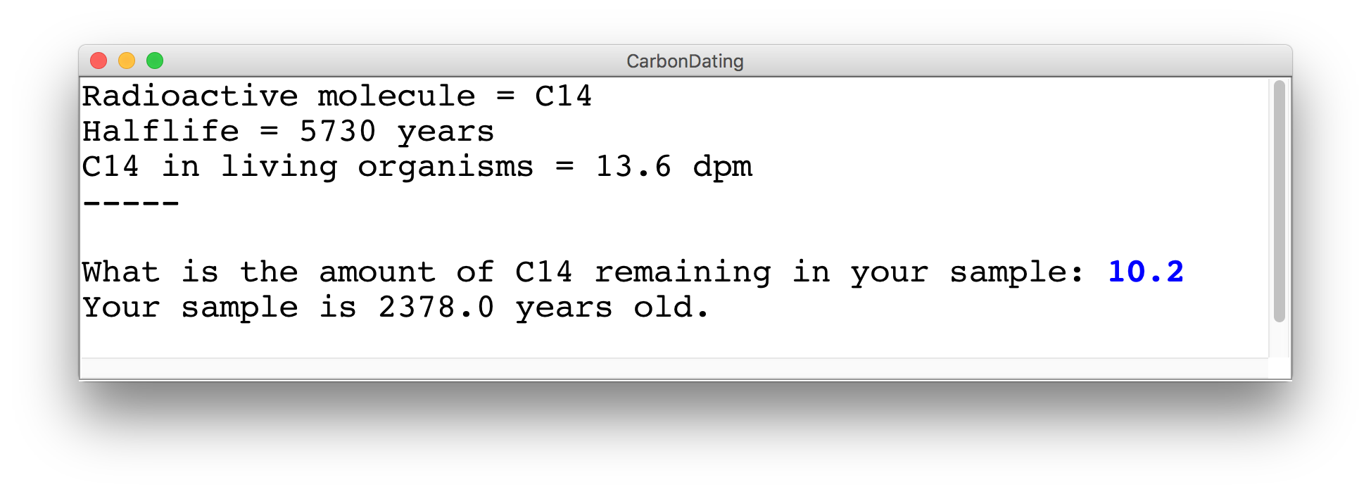
Cool Example: Carbon Dating
Write a program that can turn a measurement of C14 into an estimate of age.

Slide 12
Example: Carbon Dating
C14 = 1.2 dpm
C14 = 13.6 dpm

Slide 13
Carbon Dating Equation
Amount of C14 in your sample
Fraction of
C14 left
Half life of C14
Age of the sample
½ because of half life convention
* Some of these values are constants
** Use the function: Math.log( num )

Slide 14
Binary Operators
+
Addition
*
Multiplication
–
Subtraction
/
Division
%
Remainder
Today is your day, tio

Slide 15
Remainder
// an example of the % operator
println(17 % 4);
// reads a number from the user
int num = readInt("?: ");
// stores the ones digit
int onesDigit = num % 10;
// equal to 1 if num is odd,
// 0 if num is even.
int isOdd = num % 2;

Slide 16
End Review

Slide 17
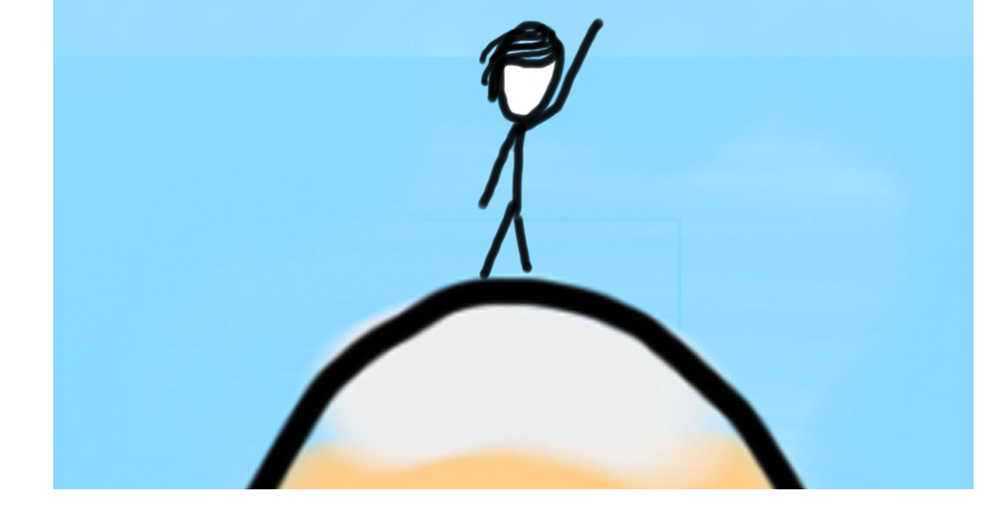

Today’s Goal
Be able to use For / While / If in Java

Slide 18



Today’s Route
You are here
Simple Java
Game
Show
For Loops
Conditions
Review
The River of Java

Slide 19
Today’s Route
You are here
Simple Java
Game
Show
For Loops
Conditions
Review
The River of Java

Slide 20
While Loop in Karel
while(frontIsClear()) {
body
}
if(beepersPresent()) {
body
}

Slide 21
While Loop Redux
while(condition) {
body
}
if(condition) {
body
}
The condition should be a “boolean” which is either true or false

Slide 22
What Does This Do?
// read the amount of C14 from the user
double amount = readDouble("Amount of C14 in your sample: ");
// use the half life formula to calculate the age
double fractionLeft = amountLeft / LIVING_C14;
double age = Math.log(fractionLeft) / Math.log(0.5) * HALF_LIFE;
println("Your sample is " + age + " years old.");
* It calculates the age of a C14 sample

Slide 23
What Does This Do?
Before repeating the body, check if this statement evaluates to true
while(true) {
// read the amount of C14 from the user
double amount = readDouble("Amount of C14 in your sample: ");
// use the half life formula to calculate the age
double fractionLeft = amountLeft / LIVING_C14;
double age = Math.log(fractionLeft) / Math.log(0.5) * HALF_LIFE;
println("Your sample is " + age + " years old.");
// add an extra line between queries
println("");
}
* It repeatedly calculates the age of a C14 sample

Slide 24
Booleans
1 < 2

Slide 25
Booleans
1 < 2
true

Slide 26
Comparison Operators
Operator | Meaning | Example | Value
== | equals | 1 + 1 == 2 | true
!= | does not equal | 3.2 != 2.5 | true
< | less than | 10 < 5 | false
> | greater than | 10 > 5 | true
<= | less than or equal to | 126 <= 100 | false
>= | greater than or equal to | 5.0 >= 5.0 | true
* All have equal precedence

Slide 27
Comparison Operators
Operator | Meaning | Example | Value
== | equals | 1 + 1 == 2 | true
!= | does not equal | 3.2 != 2.5 | true
< | less than | 10 < 5 | false
> | greater than | 10 > 5 | true
<= | less than or equal to | 126 <= 100 | false
>= | greater than or equal to | 5.0 >= 5.0 | true
* All have equal precedence
Notes:
Equals is weird because single equals is assignment!

Slide 28
Comparison Operators
if (1 < 2) {
println("1 is less than 2!");
}
int num = readInt("Enter a number: ");
if (num == 0) { println("That number is 0!");
} else {
println("That number is not 0.");
}

Slide 29
If Else Revisited
int num = readInt("Enter a number: ");
if (num == 0) {
println("Your number is 0 ");
} else {
if (num > 0) {
println("Your number is positive");
} else {
println("Your number is negative");
}
}
Notes:
No redundant conditions

Slide 30
Else If
int num = readInt("Enter a number: ");
if (num == 0) {
println("Your number is 0 ");
} else if (num > 0) {
println("Your number is positive");
} else {
println("Your number is negative");
}
Notes:
No redundant conditions

Slide 31
Example: Sentinel Loops
sentinel: A value that signals the end of user input.
sentinel loop: Repeats until a sentinel value is seen.
Example: Write a program that prompts the user for numbers until the user types -1, then output the sum of the numbers.
In this case, -1 is the sentinel value.
Type a number: 10
Type a number: 20
Type a number: 30
Type a number: -1
Sum is 60
Notes:
11:45AM
Think pair share (hint: fencepost)

Slide 32
Example: Sentinel Loops
// fencepost problem!
// ask for number - post
// add number to sum - fence
int sum = 0;
int num = readInt("Enter a number: ");
while (num != -1) {
sum += num;
num = readInt("Enter a number: ");
}
println("Sum is " + sum);

Slide 33
Example: Sentinel Loops
// Solution #2
// harder to see loop end condition here
int sum = 0;
while (true) {
int num = readInt("Enter a number: ");
if (num == -1) {
break; // immediately exits loop
}
sum += num;
}
println("Sum is " + sum);
Notes:
Break exits the closest loop it is in
”Loop and a half” – not as good style
You can have more complex conditions if you want…

Slide 34
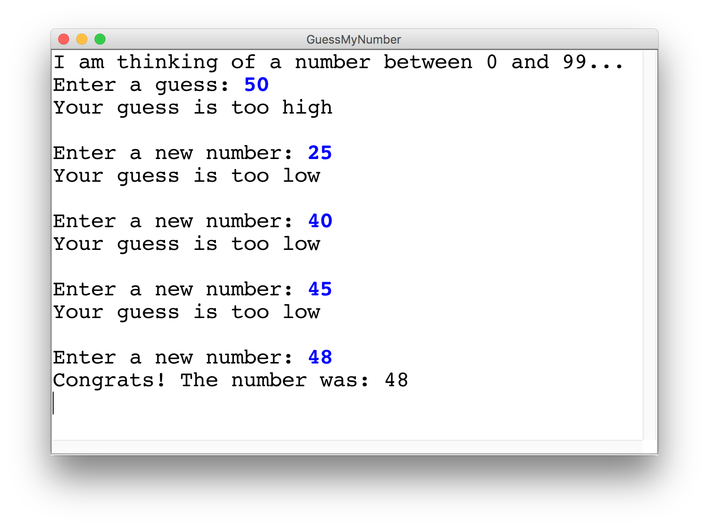
Guess My Number

Slide 35
Guess My Number
int secretNumber = getHeight() % 100;
println("I am thinking of a number between 0 and 99...");
int guess = readInt("Enter a guess: ");
// true if guess is not equal to secret number
while(guess != secretNumber) {
// true if guess is less than secret number
if(guess < secretNumber) {
println("Your guess is too low");
} else {
println("Your guess is too high");
}
println(""); // an empty line
guess = readInt("Enter a new number: ");
}
println("Congrats! The number was: " + secretNumber);
92
secretNumber

Slide 36
Guess My Number
int secretNumber = getHeight() % 100;
println("I am thinking of a number between 0 and 99...");
int guess = readInt("Enter a guess: ");
// true if guess is not equal to secret number
while(guess != secretNumber) {
// true if guess is less than secret number
if(guess < secretNumber) {
println("Your guess is too low");
} else {
println("Your guess is too high");
}
println(""); // an empty line
guess = readInt("Enter a new number: ");
}
println("Congrats! The number was: " + secretNumber);
92
secretNumber

Slide 37
Guess My Number
int secretNumber = getHeight() % 100;
println("I am thinking of a number between 0 and 99...");
int guess = readInt("Enter a guess: ");
// true if guess is not equal to secret number
while(guess != secretNumber) {
// true if guess is less than secret number
if(guess < secretNumber) {
println("Your guess is too low");
} else {
println("Your guess is too high");
}
println(""); // an empty line
guess = readInt("Enter a new number: ");
}
println("Congrats! The number was: " + secretNumber);
50
92
guess
secretNumber

Slide 38
Guess My Number
int secretNumber = getHeight() % 100;
println("I am thinking of a number between 0 and 99...");
int guess = readInt("Enter a guess: ");
// true if guess is not equal to secret number
while(guess != secretNumber) {
// true if guess is less than secret number
if(guess < secretNumber) {
println("Your guess is too low");
} else {
println("Your guess is too high");
}
println(""); // an empty line
guess = readInt("Enter a new number: ");
}
println("Congrats! The number was: " + secretNumber);
50
92
guess
secretNumber

Slide 39
Guess My Number
int secretNumber = getHeight() % 100;
println("I am thinking of a number between 0 and 99...");
int guess = readInt("Enter a guess: ");
// true if guess is not equal to secret number
while(guess != secretNumber) {
// true if guess is less than secret number
if(guess < secretNumber) {
println("Your guess is too low");
} else {
println("Your guess is too high");
}
println(""); // an empty line
guess = readInt("Enter a new number: ");
}
println("Congrats! The number was: " + secretNumber);
50
92
guess
secretNumber

Slide 40
Guess My Number
int secretNumber = getHeight() % 100;
println("I am thinking of a number between 0 and 99...");
int guess = readInt("Enter a guess: ");
// true if guess is not equal to secret number
while(guess != secretNumber) {
// true if guess is less than secret number
if(guess < secretNumber) {
println("Your guess is too low");
} else {
println("Your guess is too high");
}
println(""); // an empty line
guess = readInt("Enter a new number: ");
}
println("Congrats! The number was: " + secretNumber);
50
92
guess
secretNumber

Slide 41
Guess My Number
int secretNumber = getHeight() % 100;
println("I am thinking of a number between 0 and 99...");
int guess = readInt("Enter a guess: ");
// true if guess is not equal to secret number
while(guess != secretNumber) {
// true if guess is less than secret number
if(guess < secretNumber) {
println("Your guess is too low");
} else {
println("Your guess is too high");
}
println(""); // an empty line
guess = readInt("Enter a new number: ");
}
println("Congrats! The number was: " + secretNumber);
50
92
guess
secretNumber

Slide 42
Guess My Number
int secretNumber = getHeight() % 100;
println("I am thinking of a number between 0 and 99...");
int guess = readInt("Enter a guess: ");
// true if guess is not equal to secret number
while(guess != secretNumber) {
// true if guess is less than secret number
if(guess < secretNumber) {
println("Your guess is too low");
} else {
println("Your guess is too high");
}
println(""); // an empty line
guess = readInt("Enter a new number: ");
}
println("Congrats! The number was: " + secretNumber);
50
92
guess
secretNumber

Slide 43
Guess My Number
int secretNumber = getHeight() % 100;
println("I am thinking of a number between 0 and 99...");
int guess = readInt("Enter a guess: ");
// true if guess is not equal to secret number
while(guess != secretNumber) {
// true if guess is less than secret number
if(guess < secretNumber) {
println("Your guess is too low");
} else {
println("Your guess is too high");
}
println(""); // an empty line
guess = readInt("Enter a new number: ");
}
println("Congrats! The number was: " + secretNumber);
95
92
guess
secretNumber

Slide 44
Guess My Number
int secretNumber = getHeight() % 100;
println("I am thinking of a number between 0 and 99...");
int guess = readInt("Enter a guess: ");
// true if guess is not equal to secret number
while(guess != secretNumber) {
// true if guess is less than secret number
if(guess < secretNumber) {
println("Your guess is too low");
} else {
println("Your guess is too high");
}
println(""); // an empty line
guess = readInt("Enter a new number: ");
}
println("Congrats! The number was: " + secretNumber);
95
92
guess
secretNumber

Slide 45
Guess My Number
int secretNumber = getHeight() % 100;
println("I am thinking of a number between 0 and 99...");
int guess = readInt("Enter a guess: ");
// true if guess is not equal to secret number
while(guess != secretNumber) {
// true if guess is less than secret number
if(guess < secretNumber) {
println("Your guess is too low");
} else {
println("Your guess is too high");
}
println(""); // an empty line
guess = readInt("Enter a new number: ");
}
println("Congrats! The number was: " + secretNumber);
95
92
guess
secretNumber

Slide 46
Guess My Number
int secretNumber = getHeight() % 100;
println("I am thinking of a number between 0 and 99...");
int guess = readInt("Enter a guess: ");
// true if guess is not equal to secret number
while(guess != secretNumber) {
// true if guess is less than secret number
if(guess < secretNumber) {
println("Your guess is too low");
} else {
println("Your guess is too high");
}
println(""); // an empty line
guess = readInt("Enter a new number: ");
}
println("Congrats! The number was: " + secretNumber);
95
92
guess
secretNumber

Slide 47
Guess My Number
int secretNumber = getHeight() % 100;
println("I am thinking of a number between 0 and 99...");
int guess = readInt("Enter a guess: ");
// true if guess is not equal to secret number
while(guess != secretNumber) {
// true if guess is less than secret number
if(guess < secretNumber) {
println("Your guess is too low");
} else {
println("Your guess is too high");
}
println(""); // an empty line
guess = readInt("Enter a new number: ");
}
println("Congrats! The number was: " + secretNumber);
95
92
guess
secretNumber

Slide 48
Guess My Number
int secretNumber = getHeight() % 100;
println("I am thinking of a number between 0 and 99...");
int guess = readInt("Enter a guess: ");
// true if guess is not equal to secret number
while(guess != secretNumber) {
// true if guess is less than secret number
if(guess < secretNumber) {
println("Your guess is too low");
} else {
println("Your guess is too high");
}
println(""); // an empty line
guess = readInt("Enter a new number: ");
}
println("Congrats! The number was: " + secretNumber);
95
92
guess
secretNumber

Slide 49
Guess My Number
int secretNumber = getHeight() % 100;
println("I am thinking of a number between 0 and 99...");
int guess = readInt("Enter a guess: ");
// true if guess is not equal to secret number
while(guess != secretNumber) {
// true if guess is less than secret number
if(guess < secretNumber) {
println("Your guess is too low");
} else {
println("Your guess is too high");
}
println(""); // an empty line
guess = readInt("Enter a new number: ");
}
println("Congrats! The number was: " + secretNumber);
95
92
guess
secretNumber

Slide 50
Guess My Number
int secretNumber = getHeight() % 100;
println("I am thinking of a number between 0 and 99...");
int guess = readInt("Enter a guess: ");
// true if guess is not equal to secret number
while(guess != secretNumber) {
// true if guess is less than secret number
if(guess < secretNumber) {
println("Your guess is too low");
} else {
println("Your guess is too high");
}
println(""); // an empty line
guess = readInt("Enter a new number: ");
}
println("Congrats! The number was: " + secretNumber);
92
92
guess
secretNumber

Slide 51
Guess My Number
int secretNumber = getHeight() % 100;
println("I am thinking of a number between 0 and 99...");
int guess = readInt("Enter a guess: ");
// true if guess is not equal to secret number
while(guess != secretNumber) {
// true if guess is less than secret number
if(guess < secretNumber) {
println("Your guess is too low");
} else {
println("Your guess is too high");
}
println(""); // an empty line
guess = readInt("Enter a new number: ");
}
println("Congrats! The number was: " + secretNumber);
92
92
guess
secretNumber

Slide 52
Guess My Number
int secretNumber = getHeight() % 100;
println("I am thinking of a number between 0 and 99...");
int guess = readInt("Enter a guess: ");
// true if guess is not equal to secret number
while(guess != secretNumber) {
// true if guess is less than secret number
if(guess < secretNumber) {
println("Your guess is too low");
} else {
println("Your guess is too high");
}
println(""); // an empty line
guess = readInt("Enter a new number: ");
}
println("Congrats! The number was: " + secretNumber);
92
92
guess
secretNumber

Slide 53
Guess My Number
int secretNumber = getHeight() % 100;
println("I am thinking of a number between 0 and 99...");
int guess = readInt("Enter a guess: ");
// true if guess is not equal to secret number
while(guess != secretNumber) {
// true if guess is less than secret number
if(guess < secretNumber) {
println("Your guess is too low");
} else {
println("Your guess is too high");
}
println(""); // an empty line
guess = readInt("Enter a new number: ");
}
println("Congrats! The number was: " + secretNumber);
92
92
guess
secretNumber

Slide 54
Logical Operators
In order of precedence:
Operator | Description | Example | Result
! | not | !(2 == 3) | true
&& | and | (2 == 3) && (-1 < 5) | false
|| | or | (2 == 3) || (-1 < 5) | true
Cannot "chain" tests as in algebra; use && or || instead
// assume x is 15 // correct version
2 <= x <= 10 2 <= x && x <= 10
true <= 10 true && false
Error! false

Slide 55
Precedence Madness
Precedence:
! > arithmetic > comparison > logical
5 * 7 >= 3 + 5 * (7 – 1) && !false
Notes:
You can store boolean expressions in variables too

Slide 56
Precedence Madness
Precedence:
! > arithmetic > comparison > logical
5 * 7 >= 3 + 5 * (7 – 1) && !false
5 * 7 >= 3 + 5 * 6 && !false
Notes:
You can store boolean expressions in variables too

Slide 57
Precedence Madness
Precedence:
! > arithmetic > comparison > logical
5 * 7 >= 3 + 5 * (7 – 1) && !false
5 * 7 >= 3 + 5 * 6 && !false
5 * 7 >= 3 + 5 * 6 && true
Notes:
You can store boolean expressions in variables too

Slide 58
Precedence Madness
Precedence:
! > arithmetic > comparison > logical
5 * 7 >= 3 + 5 * (7 – 1) && !false
5 * 7 >= 3 + 5 * 6 && !false
5 * 7 >= 3 + 5 * 6 && true
35 >= 3 + 30 && true
Notes:
You can store boolean expressions in variables too

Slide 59
Precedence Madness
Precedence:
! > arithmetic > comparison > logical
5 * 7 >= 3 + 5 * (7 – 1) && !false
5 * 7 >= 3 + 5 * 6 && !false
5 * 7 >= 3 + 5 * 6 && true
35 >= 3 + 30 && true
35 >= 33 && true
Notes:
You can store boolean expressions in variables too

Slide 60
Precedence Madness
Precedence:
! > arithmetic > comparison > logical
5 * 7 >= 3 + 5 * (7 – 1) && !false
5 * 7 >= 3 + 5 * 6 && !false
5 * 7 >= 3 + 5 * 6 && true
35 >= 3 + 30 && true
35 >= 33 && true
true && true
Notes:
You can store boolean expressions in variables too

Slide 61
Precedence Madness
Precedence:
! > arithmetic > comparison > logical
5 * 7 >= 3 + 5 * (7 – 1) && !false
5 * 7 >= 3 + 5 * 6 && !false
5 * 7 >= 3 + 5 * 6 && true
35 >= 3 + 30 && true
35 >= 33 && true
true && true
true
Never write code like this ☺
Notes:
You can store boolean expressions in variables too

Slide 62
George Boole
English Mathematician 1815 – 1864
Boole died of being too cool

Slide 63
Boolean Variables
// Store expressions that evaluate to true/false
boolean x = 1 < 2; // true
boolean y = 5.0 == 4.0; // false

Slide 64
Boolean Variables
// Store expressions that evaluate to true/false
boolean x = 1 < 2; // true
boolean y = 5.0 == 4.0; // false
// Directly set to true/false
boolean isFamilyVisiting = true;
boolean isRaining = false;

Slide 65
Boolean Variables
// Store expressions that evaluate to true/false
boolean x = 1 < 2; // true
boolean y = 5.0 == 4.0; // false
// Directly set to true/false
boolean isFamilyVisiting = true;
boolean isRaining = false;
// Ask the user a true/false (yes/no) question
boolean playAgain = readBoolean("Play again?”, "y", "n");
if (playAgain) {
...
Notes:
Note: does not store the whole expression – just the value.
Note – we don’t need to check if it’s true

Slide 66
*know your logical precedence

Slide 67
Today’s Route
You are here
Simple Java
Game
Show
For Loops
Conditions
Review
The River of Java

Slide 68
Today’s Route
You are here
Simple Java
Game
Show
For Loops
Conditions
Review
The River of Java

Slide 69
How would you println “Stanford rocks socks”
100 times

Slide 70
For Loop Redux
public void run() {
for(int i = 0; i < 100; i++) {
println(“Stanford rocks socks!”);
}
}

Slide 71
For Loop Redux
Enters the loop if this condition passes
This line is run each time the code gets to the end of the ‘body’
This line is run once, just before the for loop starts
for(int i = 0; i < 100; i++) {
println(“Stanford rocks socks!”);
}

Slide 72

For Loop Redux
for(int i = 0; i < 3; i++) {
println(“Stanford rocks socks!”);
}
For Loop Redux

Slide 73
For Loop Redux
for(int i = 0; i < 3; i++) {
println(“Stanford rocks socks!”);
}
For Loop Redux

Slide 74
For Loop Redux
i
0
for(int i = 0; i < 3; i++) {
println(“Stanford rocks socks!”);
}
For Loop Redux

Slide 75
For Loop Redux
i
0
for(int i = 0; i < 3; i++) {
println(“Stanford rocks socks!”);
}
For Loop Redux

Slide 76
For Loop Redux
i
0
for(int i = 0; i < 3; i++) {
println(“Stanford rocks socks!”);
}
For Loop Redux
Stanford rocks socks

Slide 77
For Loop Redux
i
1
for(int i = 0; i < 3; i++) {
println(“Stanford rocks socks!”);
}
For Loop Redux
Stanford rocks socks

Slide 78
For Loop Redux
i
1
for(int i = 0; i < 3; i++) {
println(“Stanford rocks socks!”);
}
For Loop Redux
Stanford rocks socks

Slide 79
For Loop Redux
i
1
for(int i = 0; i < 3; i++) {
println(“Stanford rocks socks!”);
}
For Loop Redux
Stanford rocks socks
Stanford rocks socks

Slide 80
For Loop Redux
i
2
for(int i = 0; i < 3; i++) {
println(“Stanford rocks socks!”);
}
For Loop Redux
Stanford rocks socks
Stanford rocks socks

Slide 81
For Loop Redux
i
2
for(int i = 0; i < 3; i++) {
println(“Stanford rocks socks!”);
}
For Loop Redux
Stanford rocks socks
Stanford rocks socks

Slide 82
For Loop Redux
i
2
for(int i = 0; i < 3; i++) {
println(“Stanford rocks socks!”);
}
For Loop Redux
Stanford rocks socks
Stanford rocks socks
Stanford rocks socks

Slide 83
For Loop Redux
i
3
for(int i = 0; i < 3; i++) {
println(“Stanford rocks socks!”);
}
For Loop Redux
Stanford rocks socks
Stanford rocks socks
Stanford rocks socks

Slide 84
For Loop Redux
i
3
for(int i = 0; i < 3; i++) {
println(“Stanford rocks socks!”);
}
For Loop Redux
Stanford rocks socks
Stanford rocks socks
Stanford rocks socks

Slide 85
For Loop Redux
for(int i = 0; i < 3; i++) {
println(“Stanford rocks socks!”);
}
For Loop Redux
Stanford rocks socks
Stanford rocks socks
Stanford rocks socks

Slide 86
For Loop Redux
for(int i = 0; i < 3; i++) {
println(“Stanford rocks socks!”);
}
For Loop Redux
Stanford rocks socks
Stanford rocks socks
Stanford rocks socks

Slide 87
You can use the for loop variable

Slide 88
How would you println the first 100 even numbers?

Slide 89
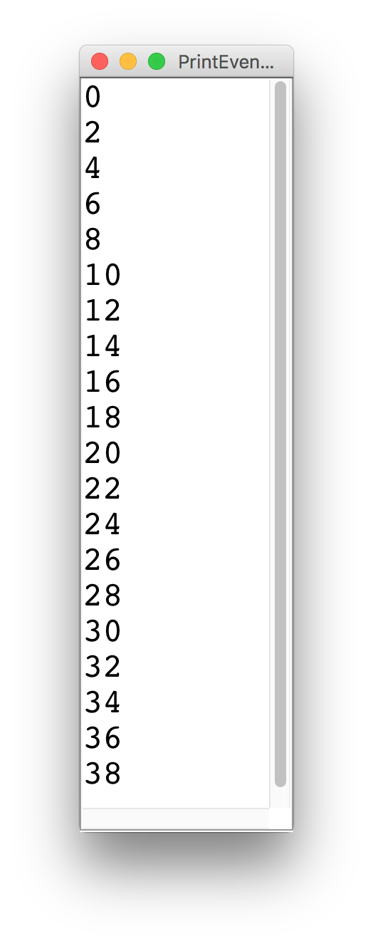
Printing Even Numbers

Slide 90
Printing Even Numbers
for(int i = 0; i < NUM_NUMS; i++) {
println(i * 2);
}

Slide 91
Printing Even Numbers
for(int i = 0; i < 3; i++) {
println(i * 2);
}
For Loop Redux

Slide 92
Printing Even Numbers
for(int i = 0; i < 3; i++) {
println(i * 2);
}
For Loop Redux

Slide 93
Printing Even Numbers
i
0
for(int i = 0; i < 3; i++) {
println(i * 2);
}
For Loop Redux

Slide 94
Printing Even Numbers
i
0
for(int i = 0; i < 3; i++) {
println(i * 2);
}
For Loop Redux

Slide 95
Printing Even Numbers
i
0
for(int i = 0; i < 3; i++) {
println(i * 2);
}
For Loop Redux
0

Slide 96
Printing Even Numbers
i
1
for(int i = 0; i < 3; i++) {
println(i * 2);
}
For Loop Redux
0

Slide 97
Printing Even Numbers
i
1
for(int i = 0; i < 3; i++) {
println(i * 2);
}
For Loop Redux
0

Slide 98
Printing Even Numbers
i
1
for(int i = 0; i < 3; i++) {
println(i * 2);
}
For Loop Redux
0
2

Slide 99
Printing Even Numbers
i
2
for(int i = 0; i < 3; i++) {
println(i * 2);
}
For Loop Redux
0
2

Slide 100
Printing Even Numbers
i
2
for(int i = 0; i < 3; i++) {
println(i * 2);
}
For Loop Redux
0
2

Slide 101
Printing Even Numbers
i
2
for(int i = 0; i < 3; i++) {
println(i * 2);
}
For Loop Redux
0
2
4

Slide 102
Printing Even Numbers
i
3
for(int i = 0; i < 3; i++) {
println(i * 2);
}
For Loop Redux
0
2
4

Slide 103
Printing Even Numbers
i
3
for(int i = 0; i < 3; i++) {
println(i * 2);
}
For Loop Redux
0
2
4

Slide 104
Printing Even Numbers
i
3
for(int i = 0; i < 3; i++) {
println(i * 2);
}
For Loop Redux
0
2
4

Slide 105
Printing Even Numbers
for(int i = 0; i < 3; i++) {
println(i * 2);
}
For Loop Redux
0
2
4

Slide 106
Today’s Route
You are here
Simple Java
Game
Show
For Loops
Conditions
Review
The River of Java

Slide 107
Today’s Route
You are here
Simple Java
Game
Show
For Loops
Conditions
Review
The River of Java

Slide 108
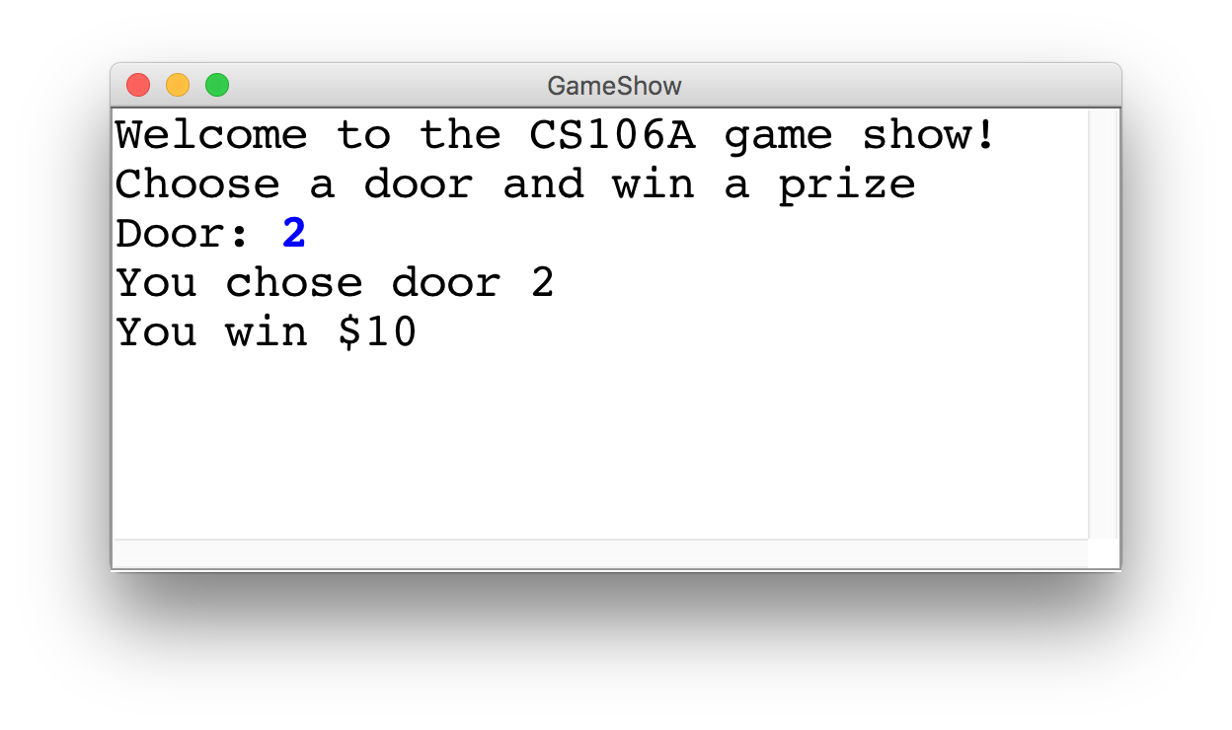
Game Show

Slide 109
Choose a Door
int door = readInt("Door: ");
// while the input is invalid
while(door < 1 || door > 3) {
// tell the user the input was invalid
println("Invalid door!");
// ask for a new input
door = readInt("Door: ");
}
|| or
&& and

Slide 110
The Door Logic
int prize = 4;
if(door == 1) {
prize = 2 + 9 / 10 * 100;
} else if(door == 2) {
boolean locked = prize % 2 != 0;
if(!locked) {
prize += 6;
}
} else if(door == 3) {
prize++;
}

Slide 111
The Door Logic
int prize = 4;
if(door == 1) {
prize = 2 + 9 / 10 * 100;
} else if(door == 2) {
boolean locked = prize % 2 != 0;
if(!locked) {
prize += 6;
}
} else if(door == 3) {
prize++;
}

Slide 112
The Door Logic
int prize = 4;
if(door == 1) {
prize = 2 + 9 / 10 * 100;
} else if(door == 2) {
boolean locked = prize % 2 != 0;
if(!locked) {
prize += 6;
}
} else if(door == 3) {
prize++;
}

Slide 113
The Door Logic
int prize = 4;
if(door == 1) {
prize = 2 + 9 / 10 * 100;
} else if(door == 2) {
boolean locked = prize % 2 != 0;
if(!locked) {
prize += 6;
}
} else if(door == 3) {
prize++;
}

Slide 114
The Door Logic
int prize = 4;
if(door == 1) {
prize = 2 + 9 / 10 * 100;
} else if(door == 2) {
boolean locked = prize % 2 != 0;
if(!locked) {
prize += 6;
}
} else if(door == 3) {
prize++;
}

Slide 115
Today’s Goal
Be able to use For / While / If in Java

